Slide 1
PneumonNet
Flatiron Capstone
Jack Risse
Notes:
Hey y’all my name is Jack Risse. Before I start I want to say please if you have any questions keep them for the end of the presentation and I will be happy to answer them at the end. My capstone project is diagnosing pneumonia using computer vision and deep learning. When the project was assigned, I told myself to come up with an idea that would one impress any future employers and two I thought about my future job because I don’t just want to analyze business data that doesn’t help a consumer directly and sometimes companies just wanting maximization of profit. I want to be able to help someone or if not help someone then innovate for the future. I think this project represents these two ideas.

Slide 2
Pneumonia
Leading worldwide cause of death to children under the age of 5
2nd most misdiagnosed disease when a patient is readmitted
Notes:
What is pneumonia? Pneumonia is an infection in lungs that can possibly lead to death. It is the world's leading cause of death to children under the of 5. It also common for hospital patients to catch pneumonia which can cause sepsis.

Slide 3
Why?
To help doctors focus on the patient side of their job
If doctors are able to focus on their patients more, patients might not be as scared and nervous because a relationship can be established between a doctor and the patient
100,000 people die annually due to misdiagnosis
Notes:
If a software can be able to diagnose diseases from medical images then that allows a doctor be able to focus on the patient and not diagnosing their condition.\

Slide 4
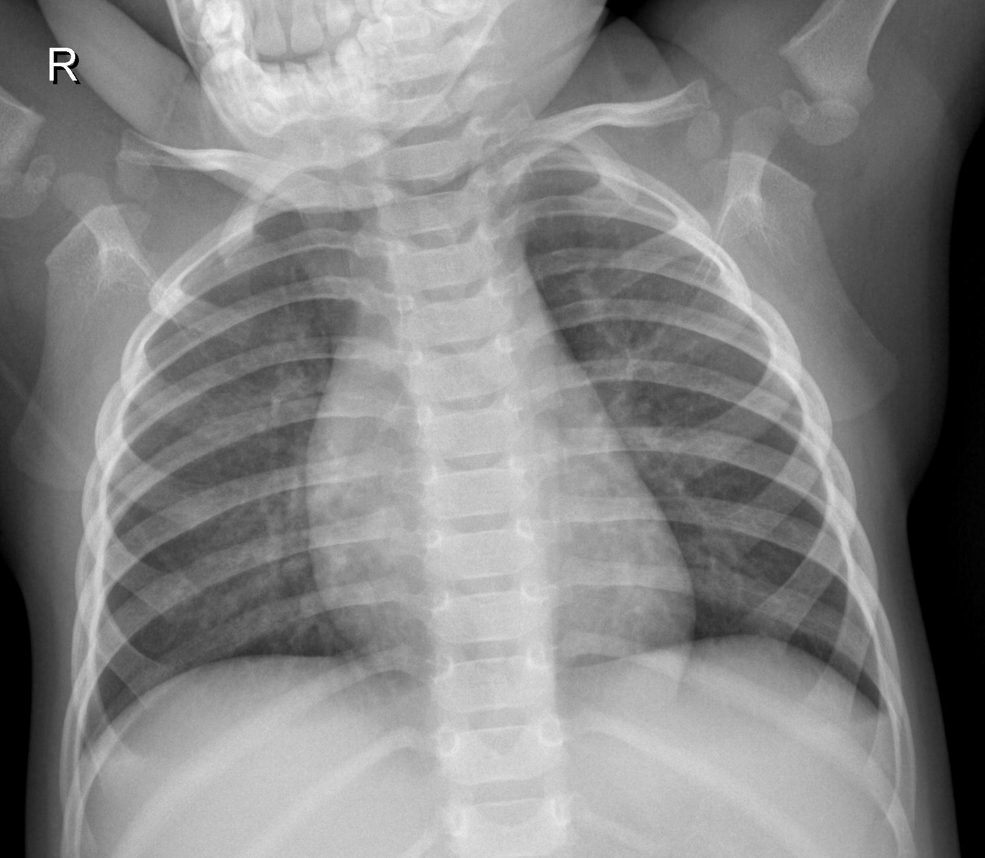
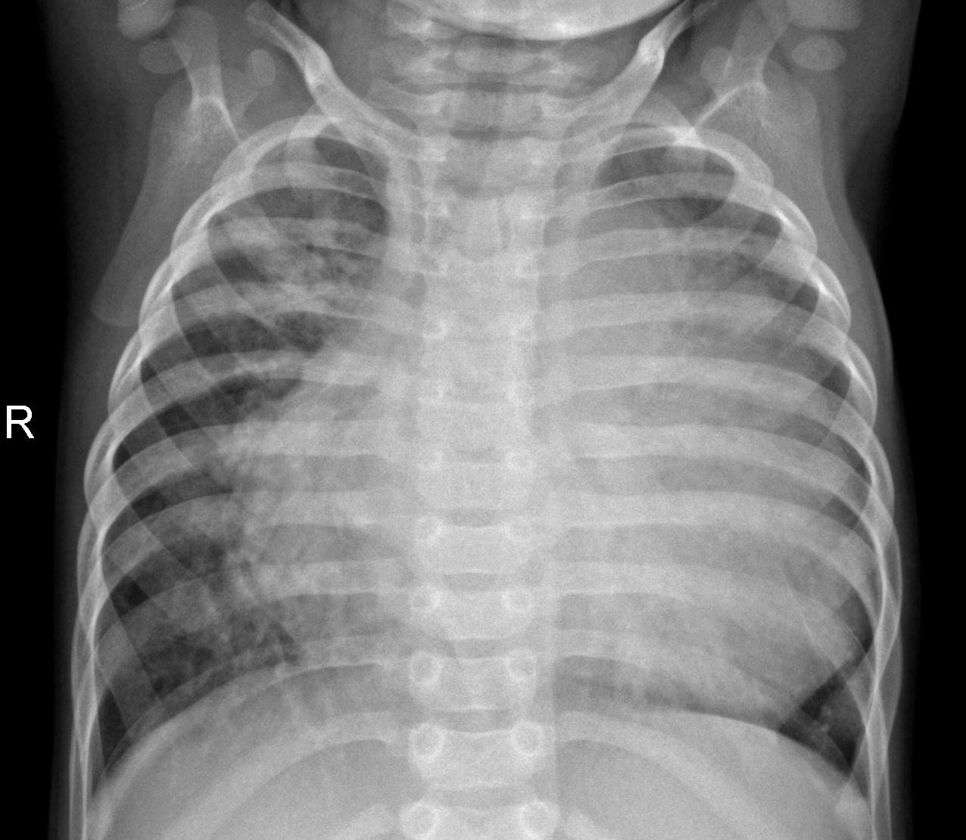
Normal
Bacterial Pneumonia

Slide 5
The PneumonNet
Using transfer learning

Slide 6
Results
Testing
Accuracy : 96.2%
Recall : 94.5%
Precision : 98.9%
Beat kaggle competition winner
Notes:
The testing accuracy and recall are the metrics we’re going to focus on. So in the medical industry accuracy isn’t heavily focused on when comparing performance because it can be misleading. The industry uses a metric called recall because the recall metric explains how well it doesn’t predict a false negative. So a 94.5 percent recall means that when the model predicts that a patient has pneumonia and the diagnosis is pneumonia, 94.5 percent of the time. Think of you and your doctor says you don’t have pneumonia but in reality you have pneumonia.

Slide 7
Future Work
Gathering more x-rays from radiology companies
Diagnose other chest and lung diseases
Have the model be able to detect where exactly the infection is

Slide 8
Thank you.
Notes:
Thank yall for coming and listening. I also can’t forget to thank my parents for allowing me the opportunity to attend Flatiron and finally I want to thank Flatiron. Now at this time I will be taking any questions.

